Slide 1

Presentation on
Social Media Project Using Django
Course Code: CSE378
Presented By
Name : Jamil Rayhan
Student ID : 18CSE061
Dept. of CSE,
Bangabandhu Sheikh Mujibur Rahman Science and Technology University
Gopalganj, Bangladesh
Supervised By
Md. Monowar Hossain
Assistant Professor
Dept. of CSE,
Bangabandhu Sheikh Mujibur Rahman Science and Technology University
Gopalganj, Bangladesh
19th July, 2023

Slide 2
Outlines
Introduction
Related Works
Methodology
Visualization
Conclusion
References

Slide 3
What is Social Media?
Social Media is defined by Boundless.com as interactive platforms where content is created, distributed and shared by individuals on the web.
What is it’s purpose?
To provide users with a rich experience, dynamic content, scalability, openness, and collective intelligence (B. , 2016, May 26).

Slide 4
Introduction
This project aims to revolutionize social media by creating an innovative platform that meets the changing needs of users.
Through advanced technology and user-centric design, will deliver a dynamic and engaging social media experience.
This project acknowledges the increasing demand for unique and interactive platforms in the rapidly evolving social media landscape.
Backgrounds
Aims and Objectives
Target Audience

Slide 5
Introduction
Develop a user-friendly and intuitive social media platform that promotes seamless communication and connection between users.
Implement advanced privacy and security features to ensure the protection of user data and maintain a safe online environment.
Foster user engagement and satisfaction by providing a range of interactive features and personalized content recommendations.
Backgrounds
Aims and Objectives
Target Audience

Slide 6
Introduction
My target audience comprises individuals of all demographics seeking a dynamic and inclusive online community.
I aim to contribute to their digital experience by providing a platform that encourages authentic connections, fosters self-expression, and promotes valuable content sharing.
Through user-generated contributions, our platform will foster a diverse and engaging online environment where individuals can connect, learn, and inspire one another.
Backgrounds
Aims and Objectives
Target Audience & Contribution

Slide 7
Outlines
Introduction
Related Works
Methodology
Visualization
Conclusion
References

Slide 8

Related Works
Related Works : Several social media platforms have made significant contributions to the way people connect and share information online, such as
Facebook,
Twitter,
Instagram
LinkedIn.
These platforms have paved the way for user-generated content, real-time updates, and targeted advertising. My project builds upon their successes while introducing new features and a fresh user experience to differentiate.

Slide 9
Outlines
Introduction
Related Works
Methodology
Visualization
Conclusion
References

Slide 10
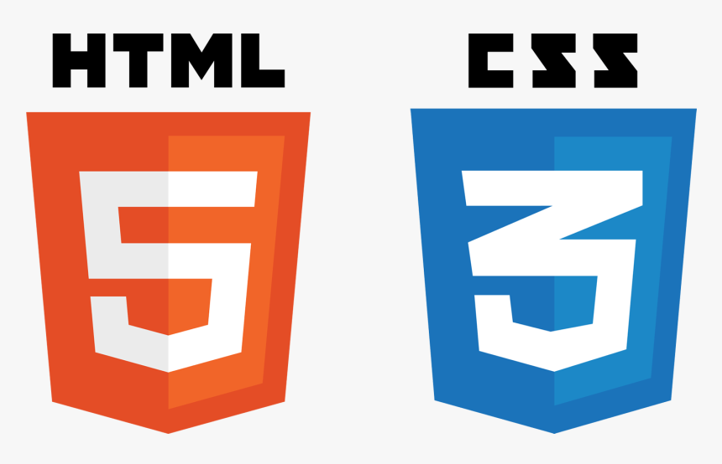




Methodology
Materials:
Languages that I used :
HTML, CSS, Bootstrap, Python, Django
Database: SQLite
Window Design:
Utilizes a user-friendly graphical user interface (GUI) following industry-standard practices.
Window Toolkit:
Visual Studio Code, PyCharm , Brave Browser

Slide 11
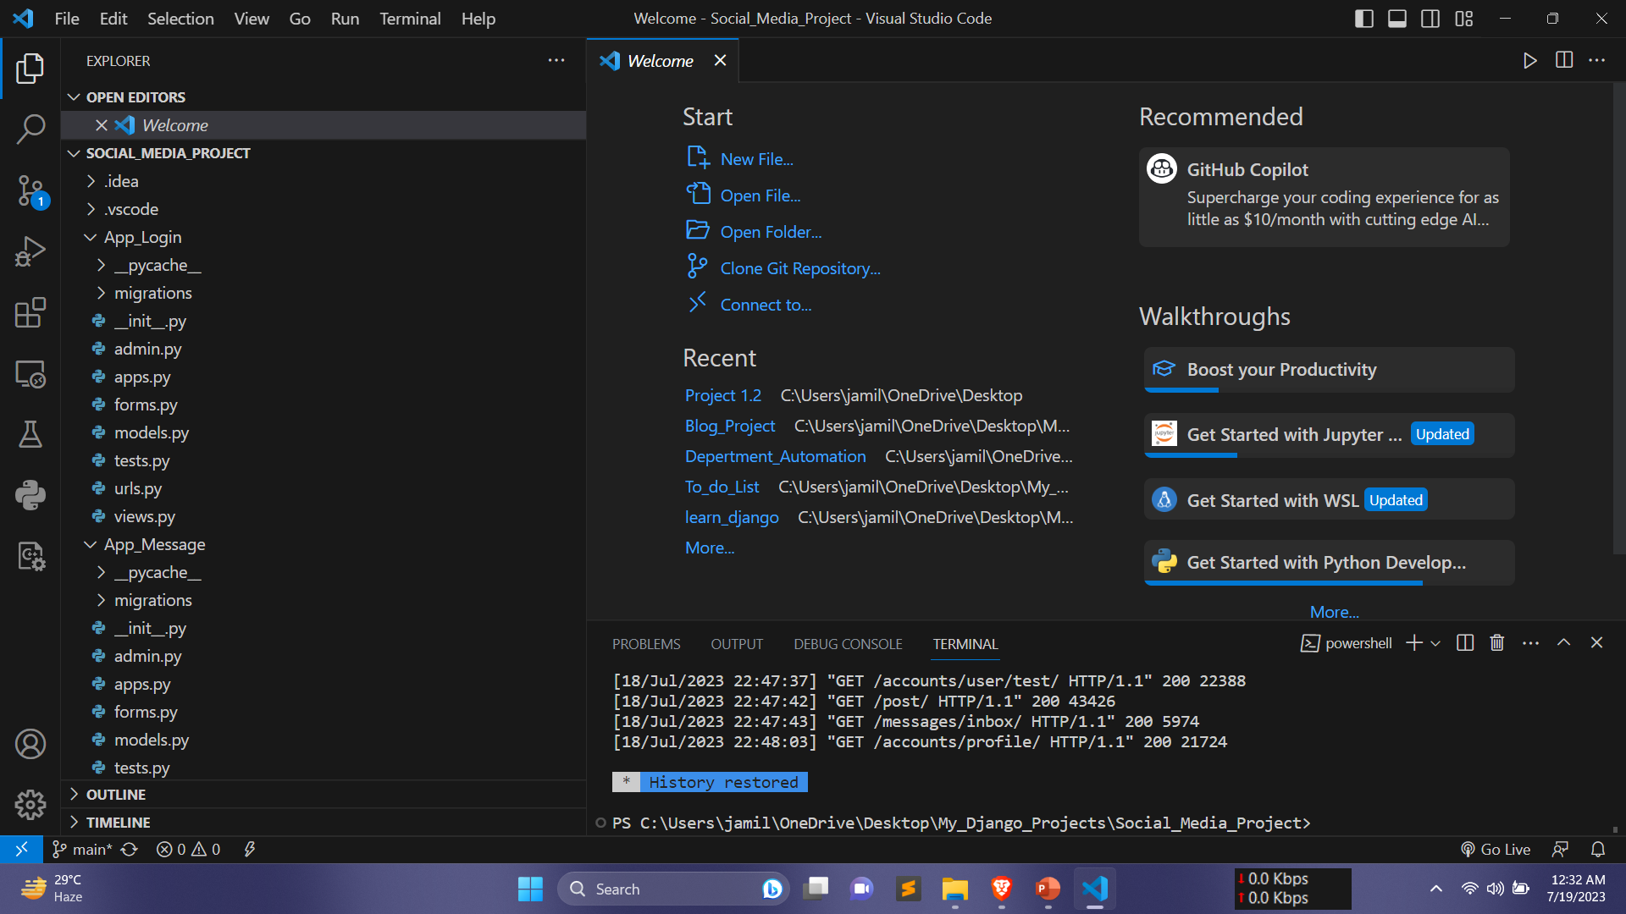
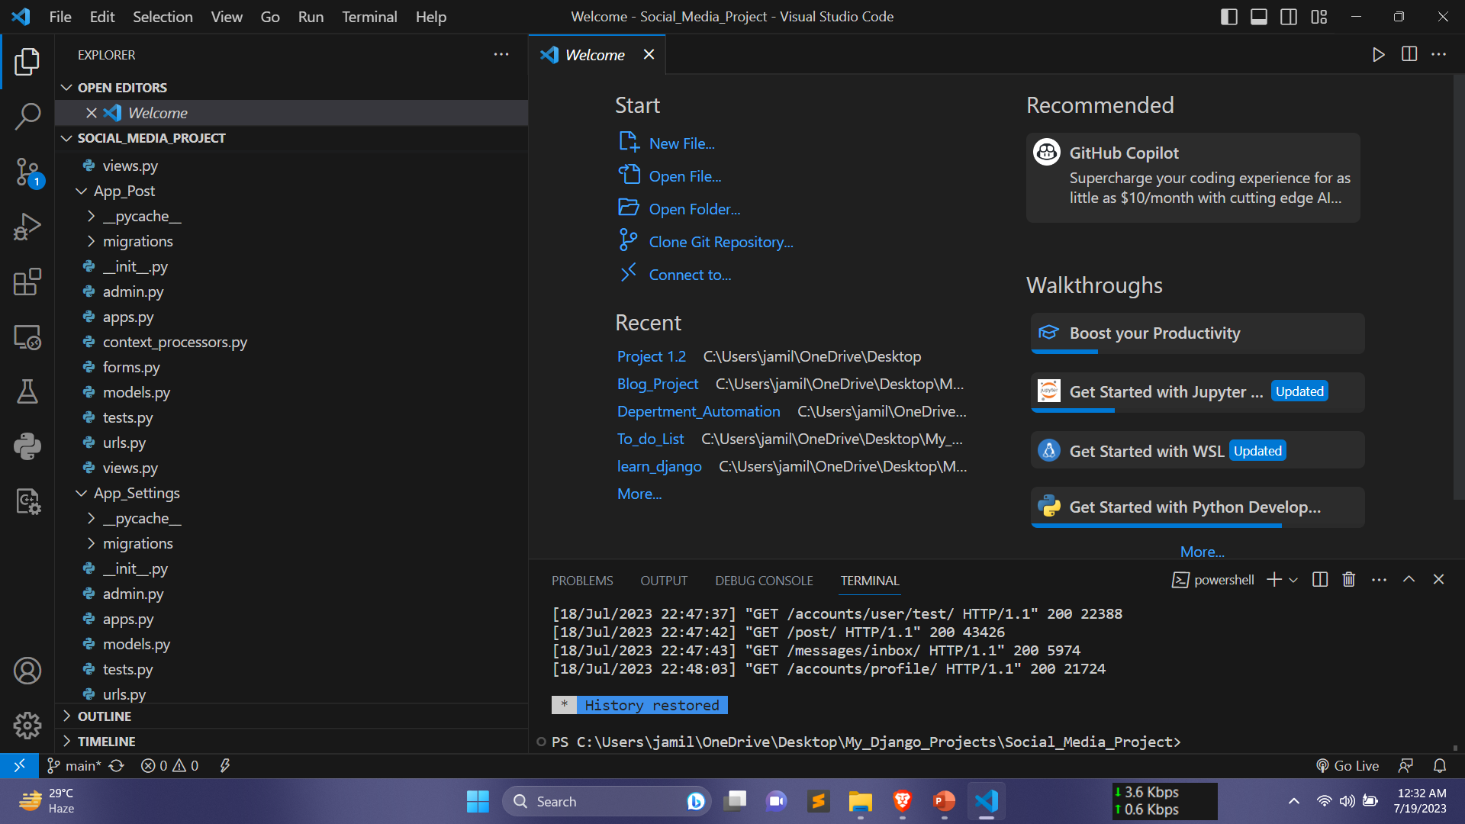
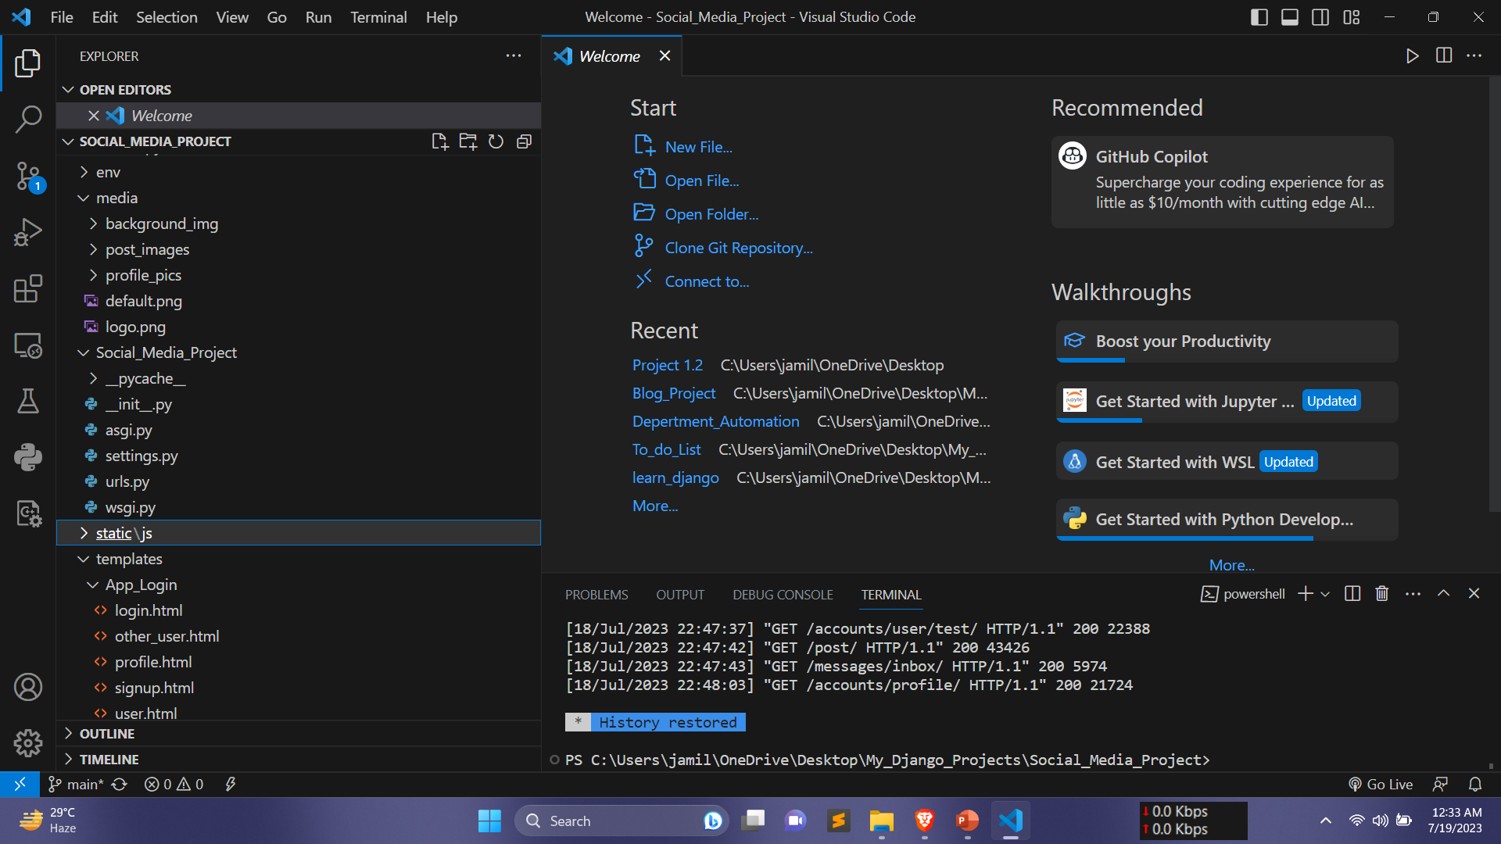
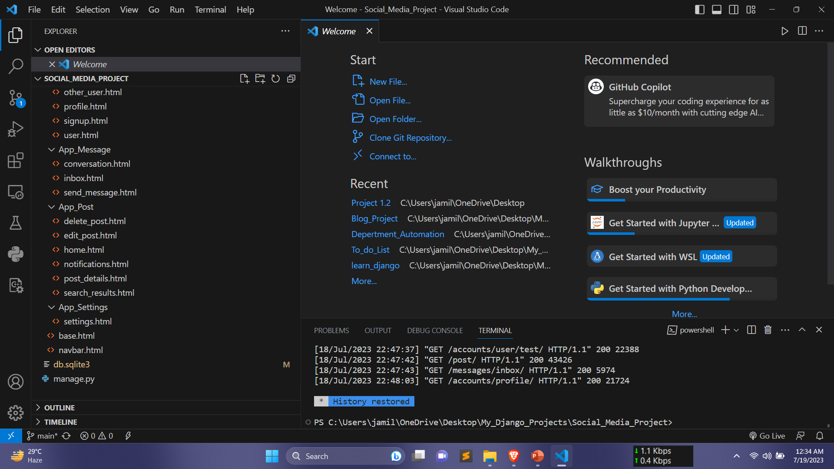
Methodology (cont.)
File Structure:

Slide 12
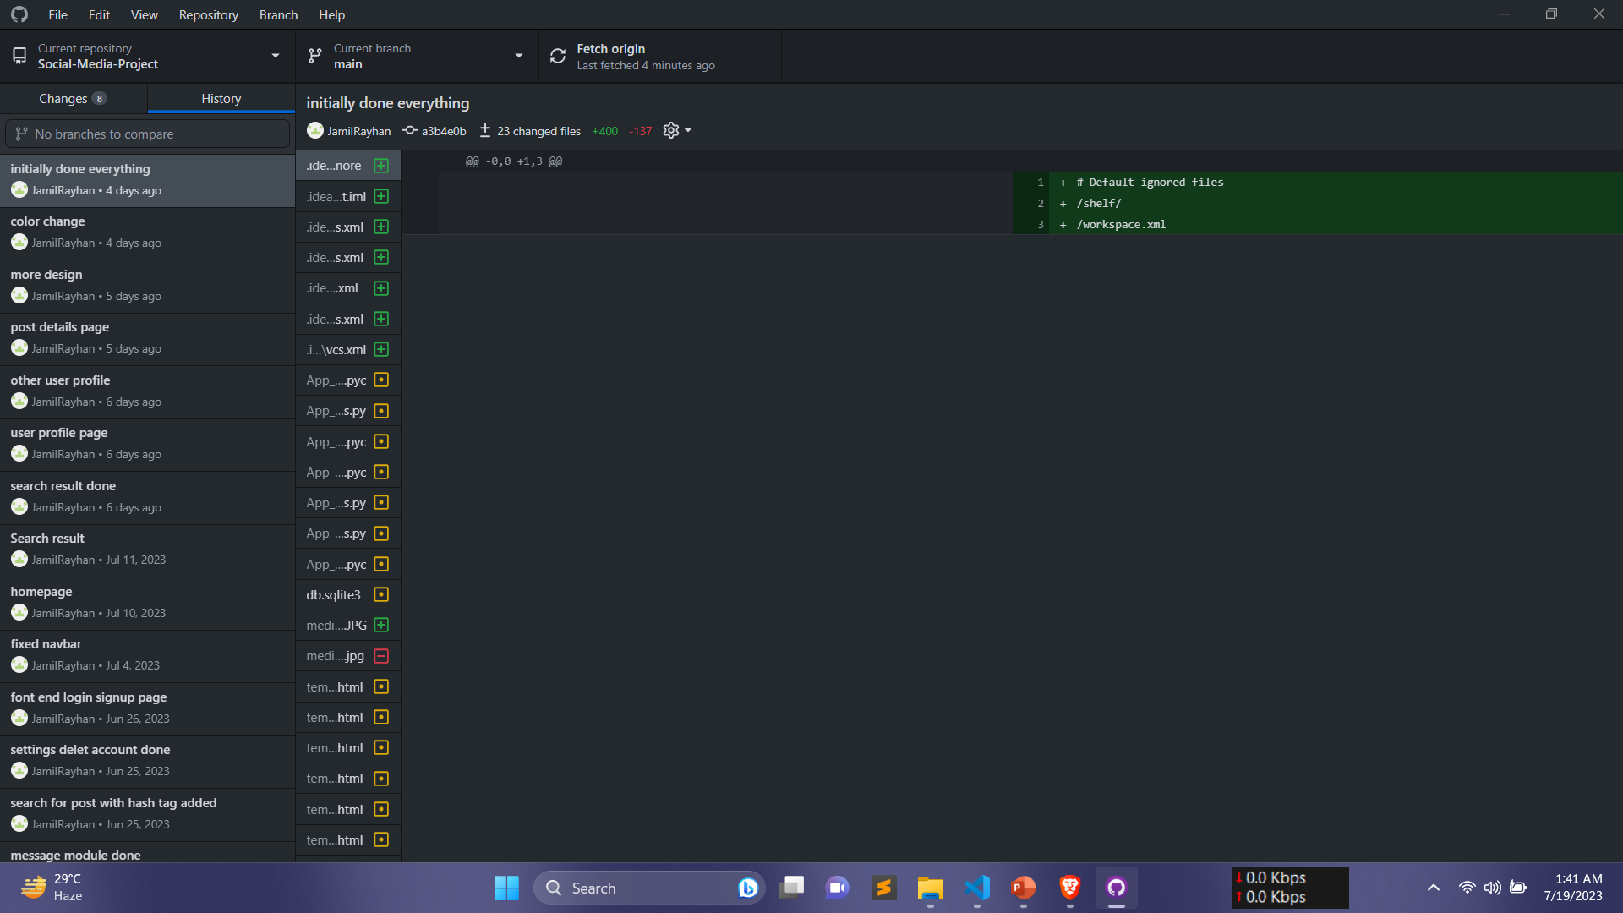
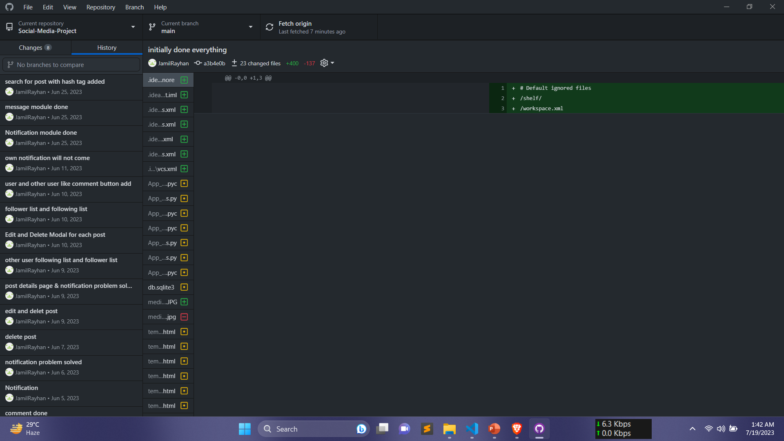
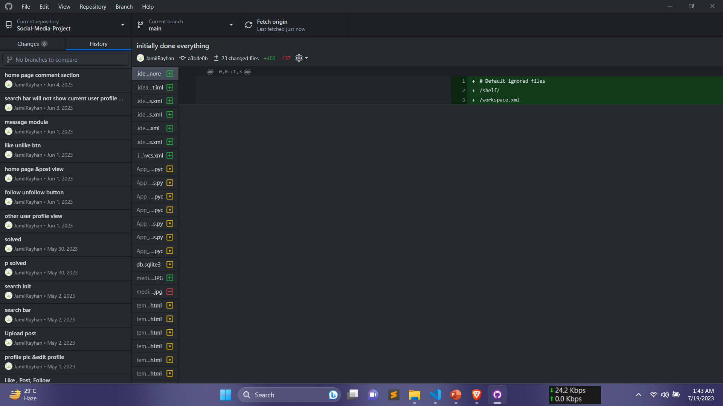
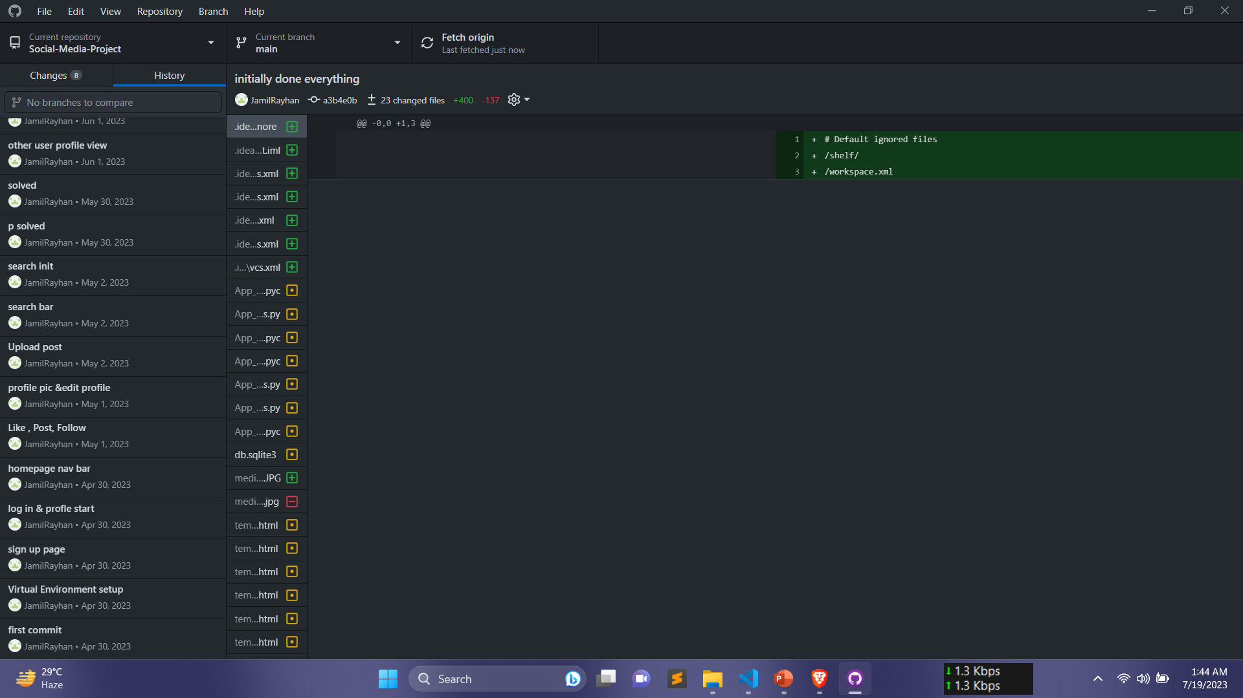
Methodology (cont.)
Github Follow ups:

Slide 13
Outlines
Introduction
Related Works
Methodology
Visualization
Conclusion
References

Slide 14
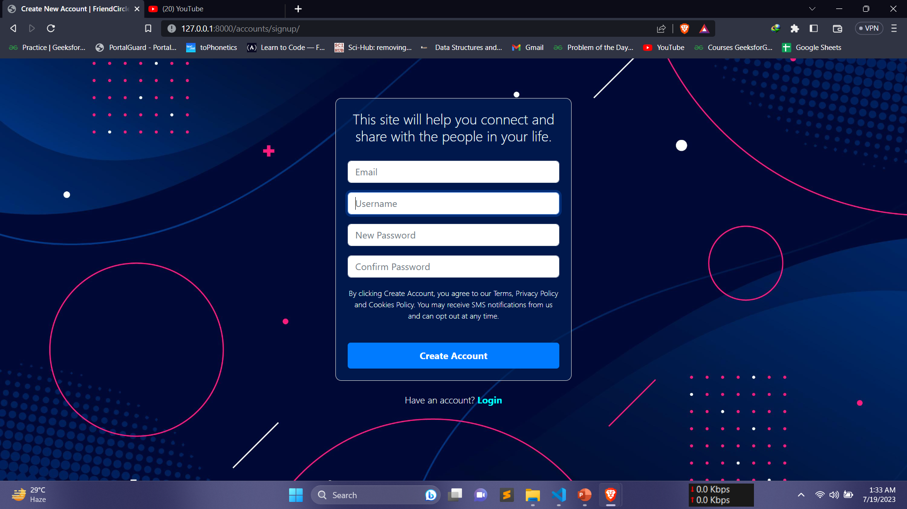
Project Visualization

Slide 15
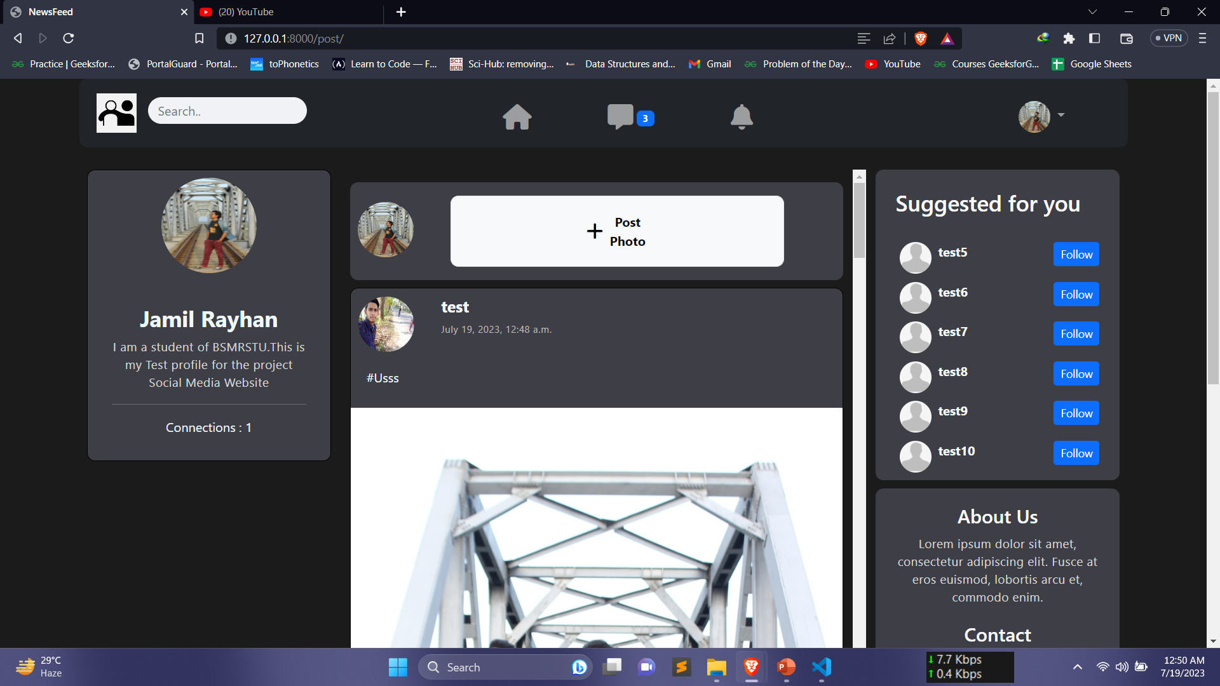
Project Visualization

Slide 16
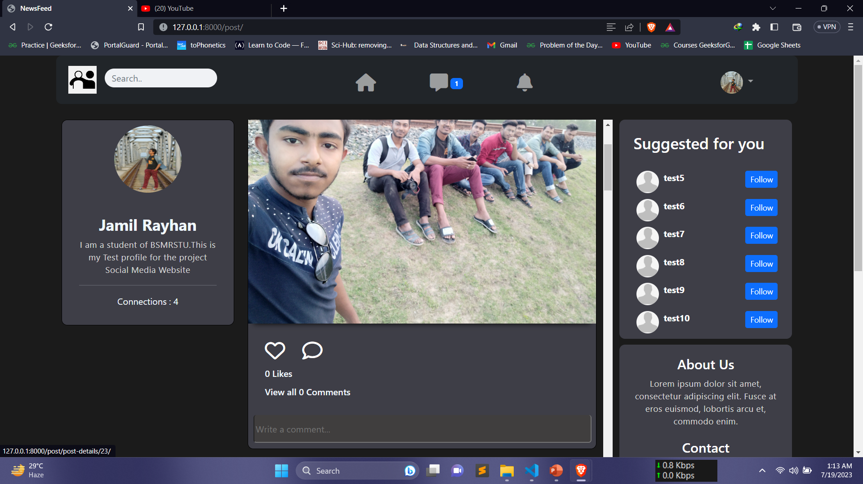
Project Visualization(cont.)

Slide 17
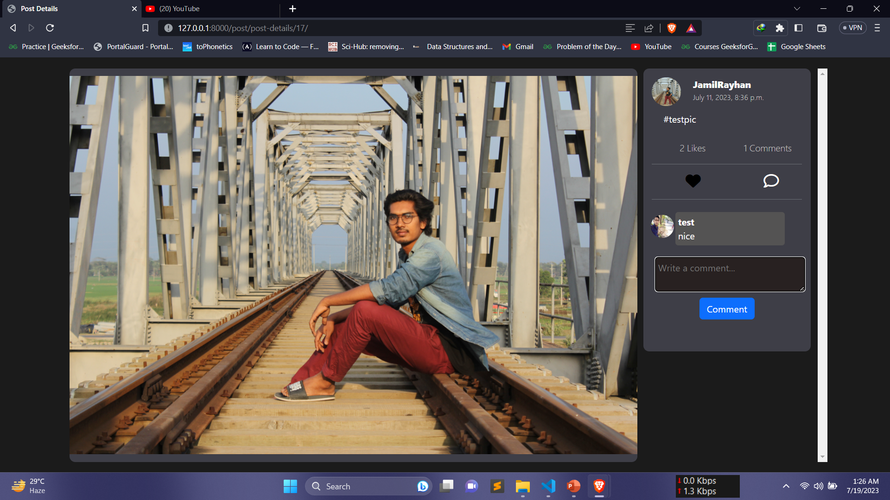
Project Visualization(cont.)

Slide 18
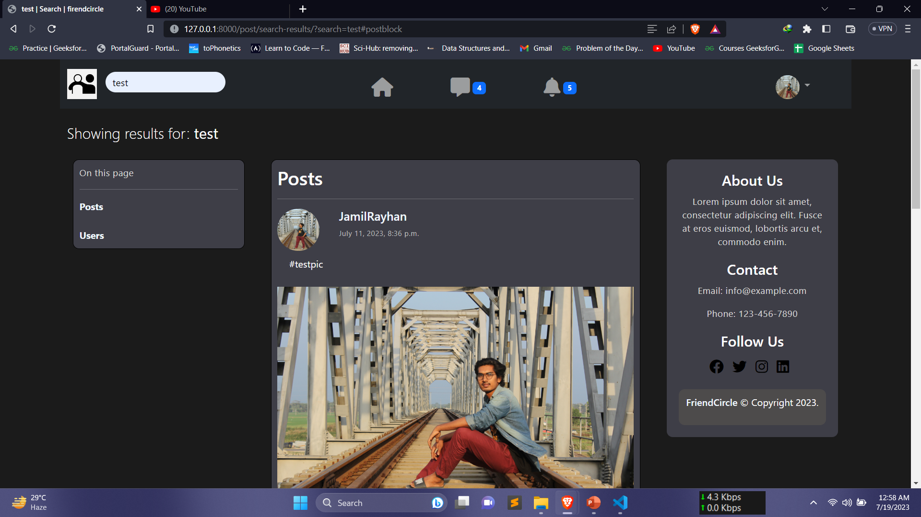
Project Visualization(cont.)

Slide 19
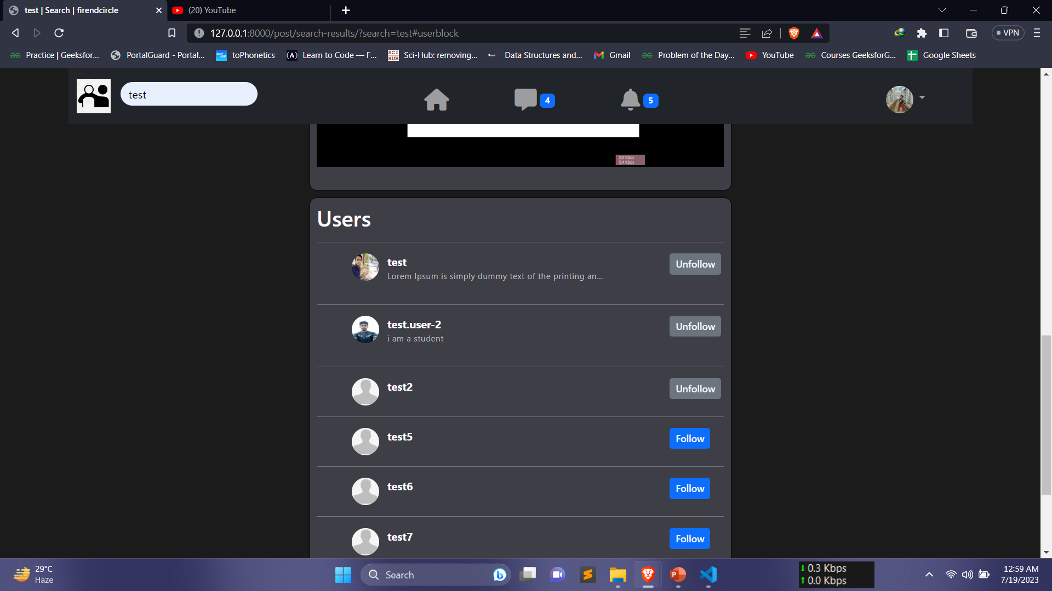
Project Visualization(cont.)

Slide 20
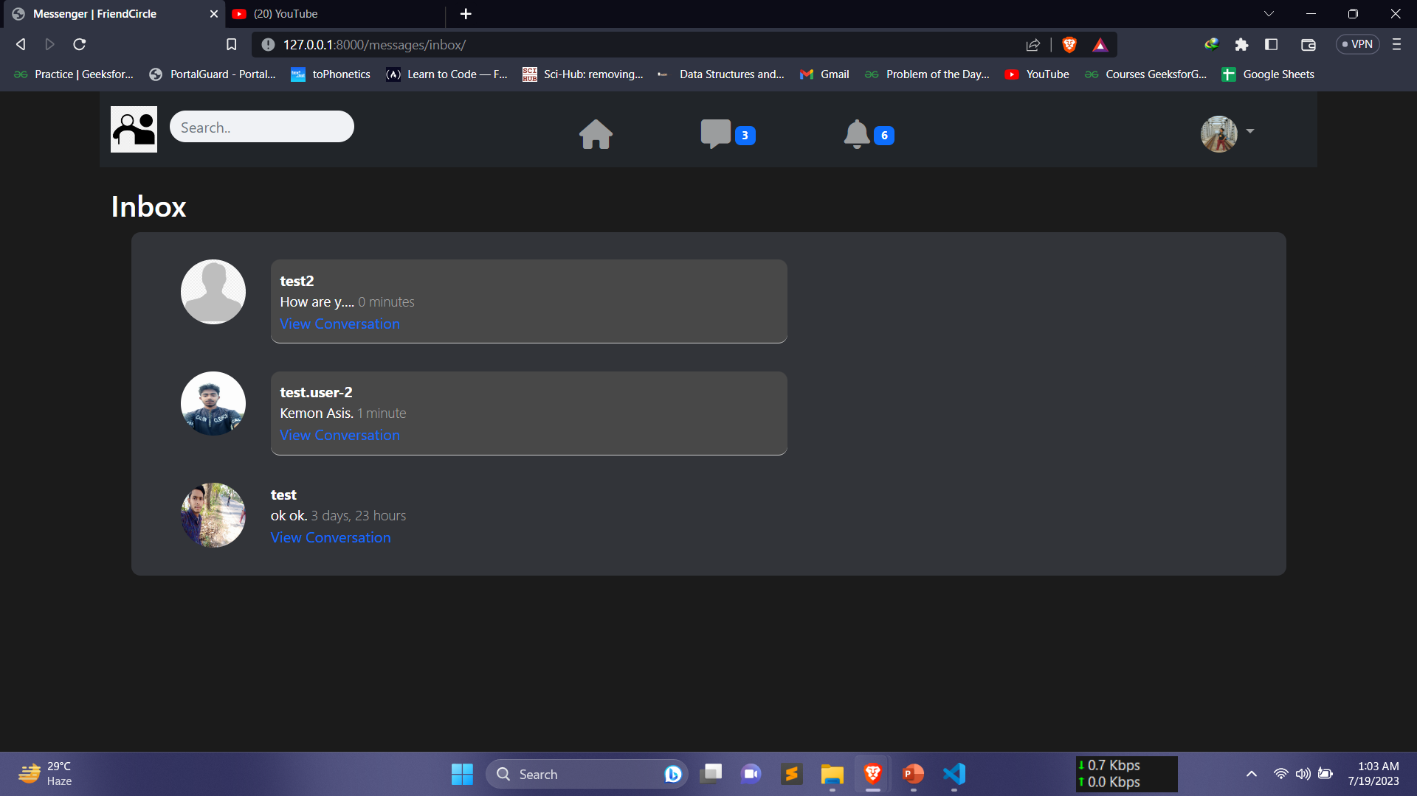
Project Visualization(cont.)

Slide 21
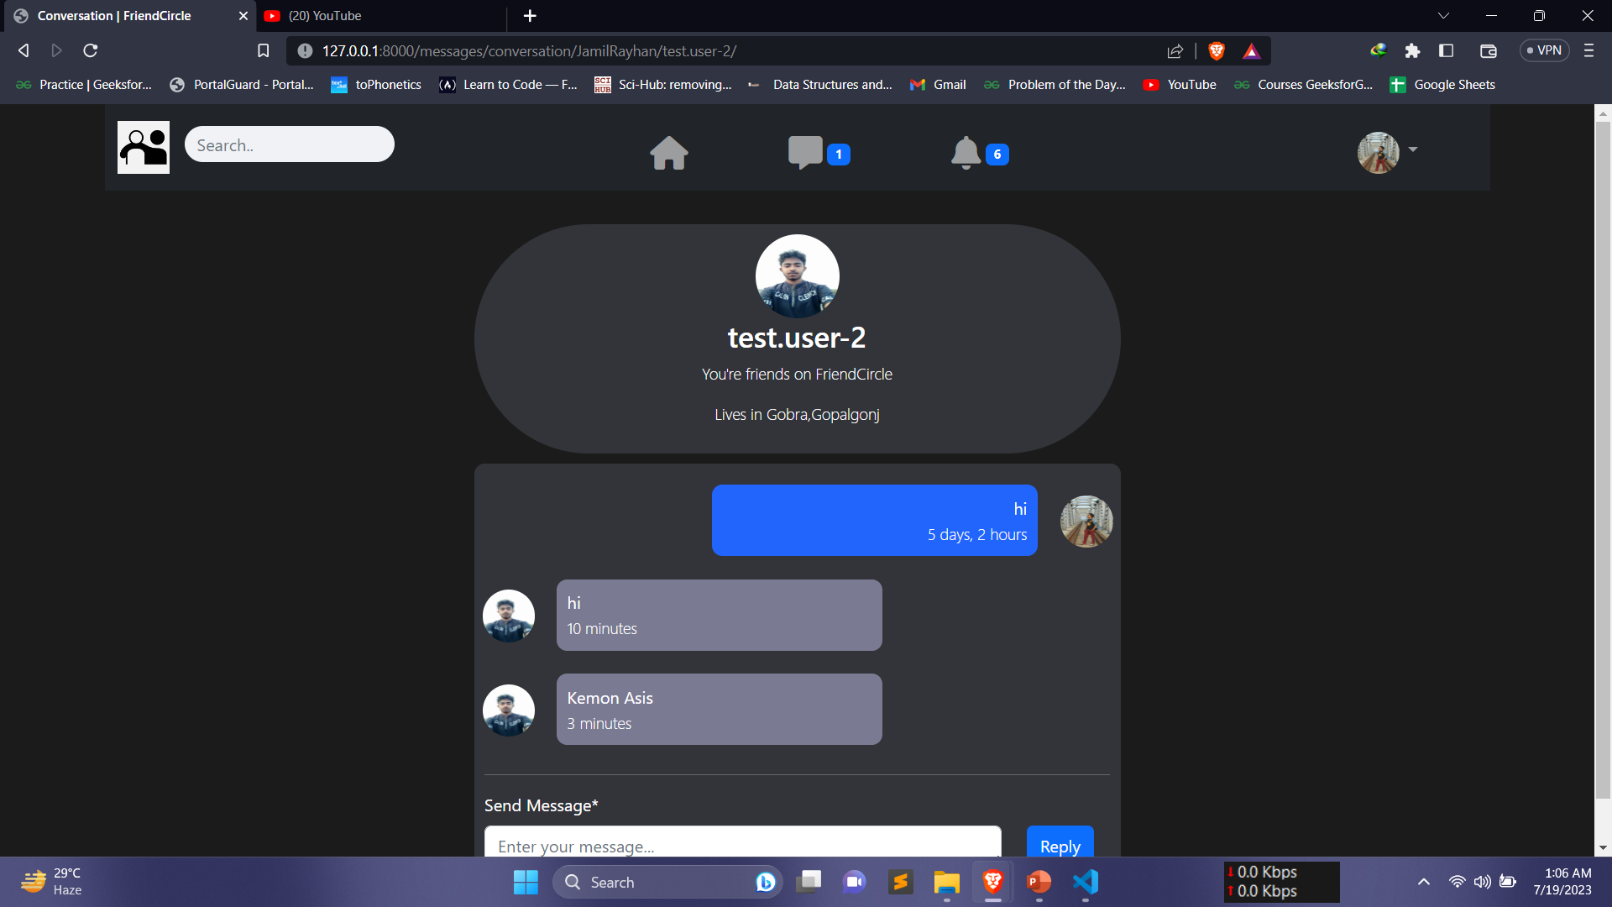
Project Visualization(cont.)

Slide 22
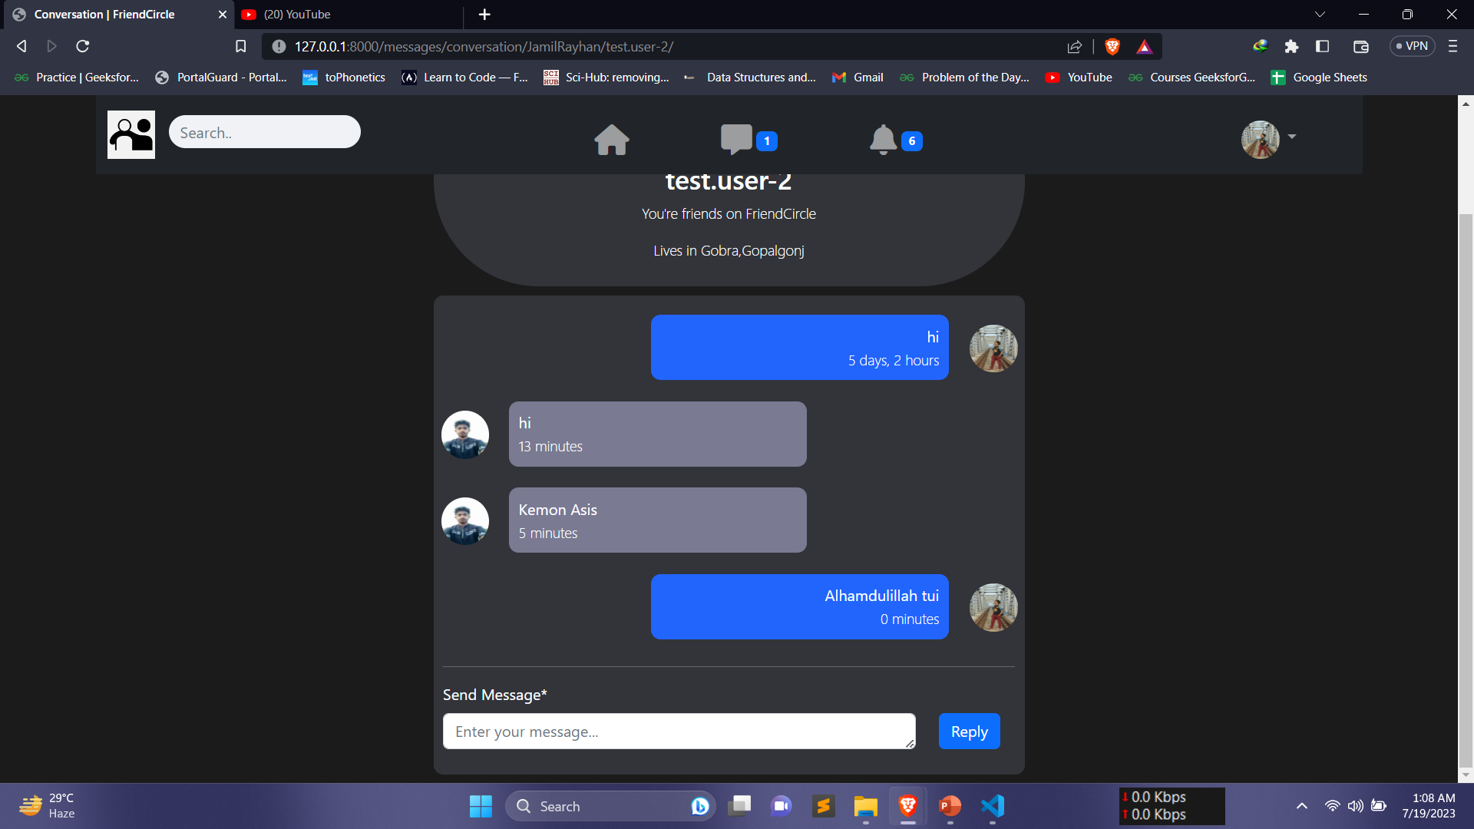
Project Visualization(cont.)

Slide 23
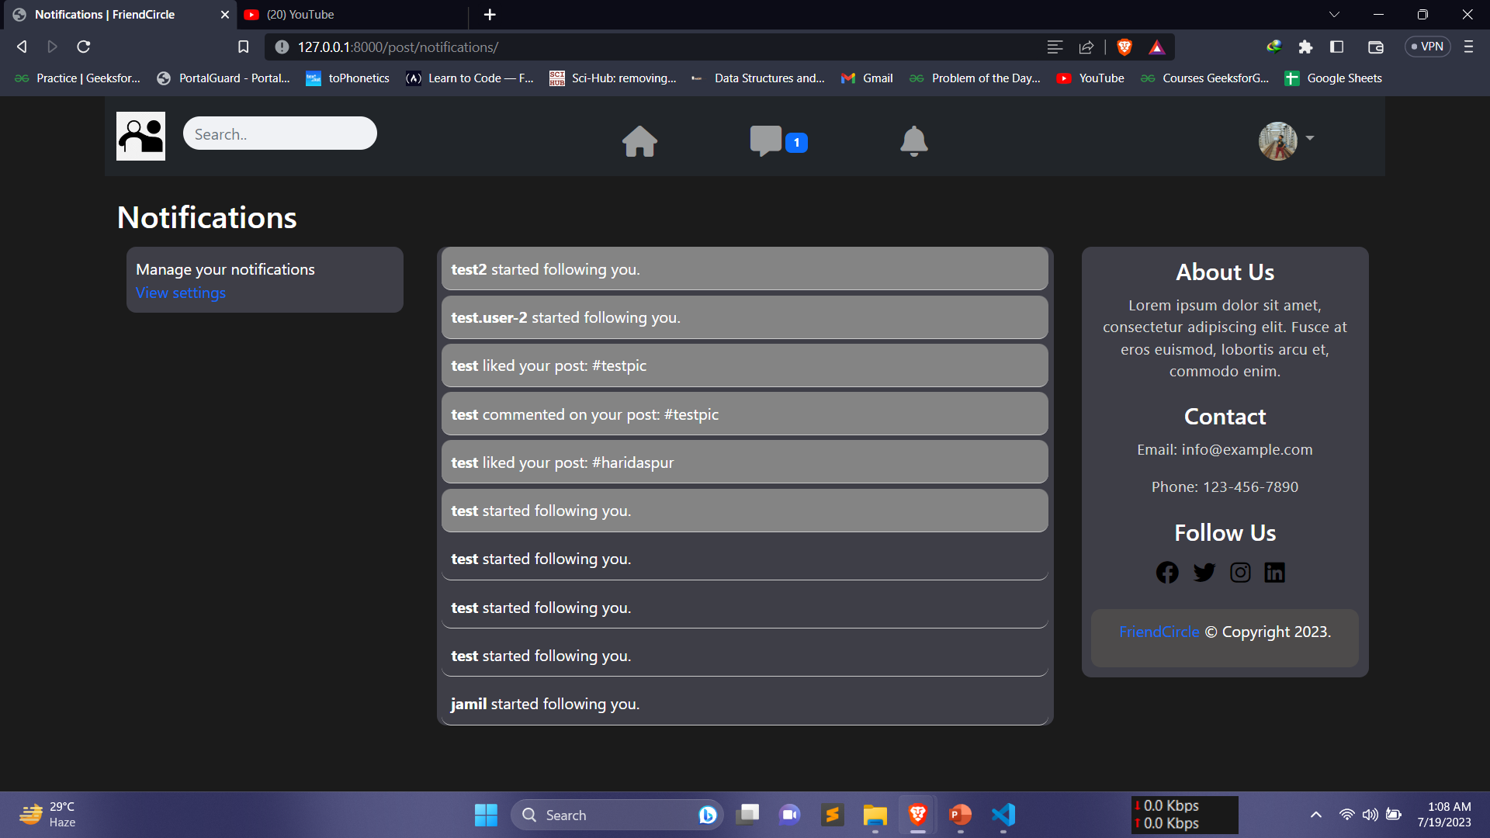
Project Visualization(cont.)

Slide 24
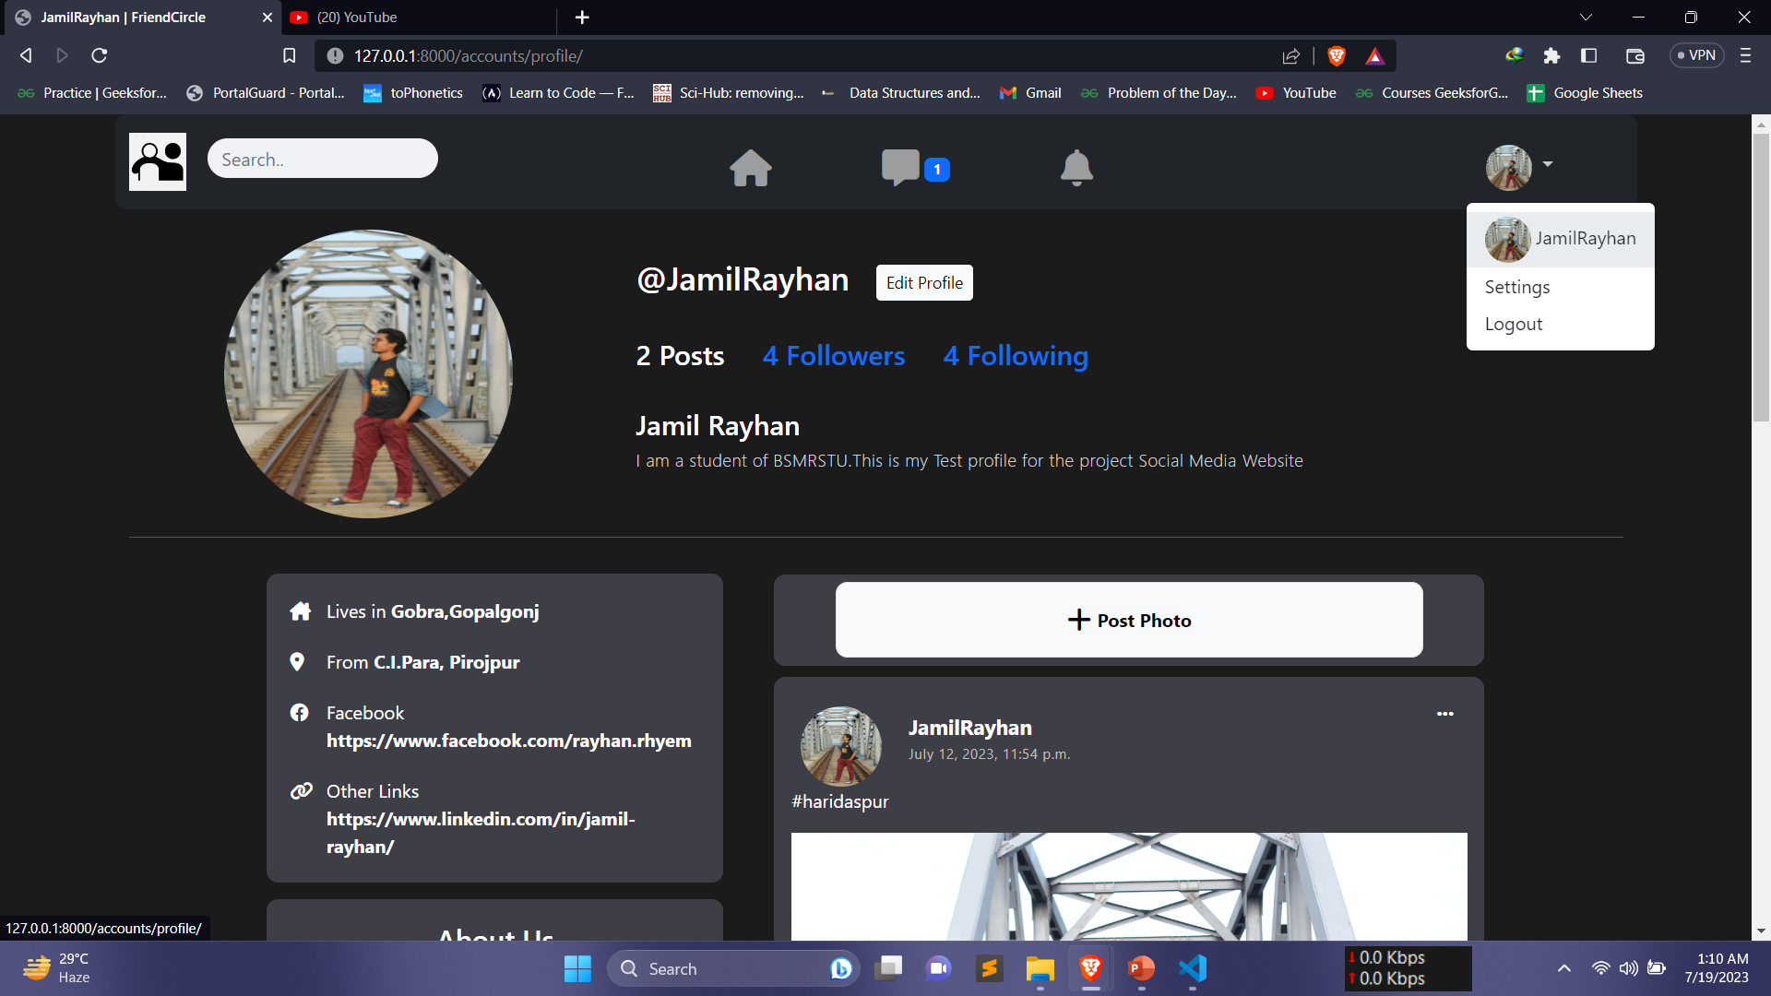
Project Visualization(cont.)

Slide 25
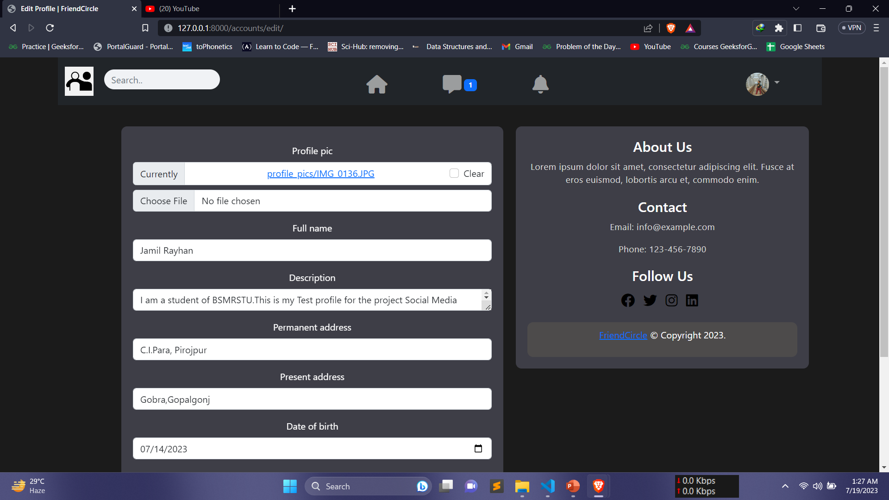
Project Visualization(cont.)

Slide 26
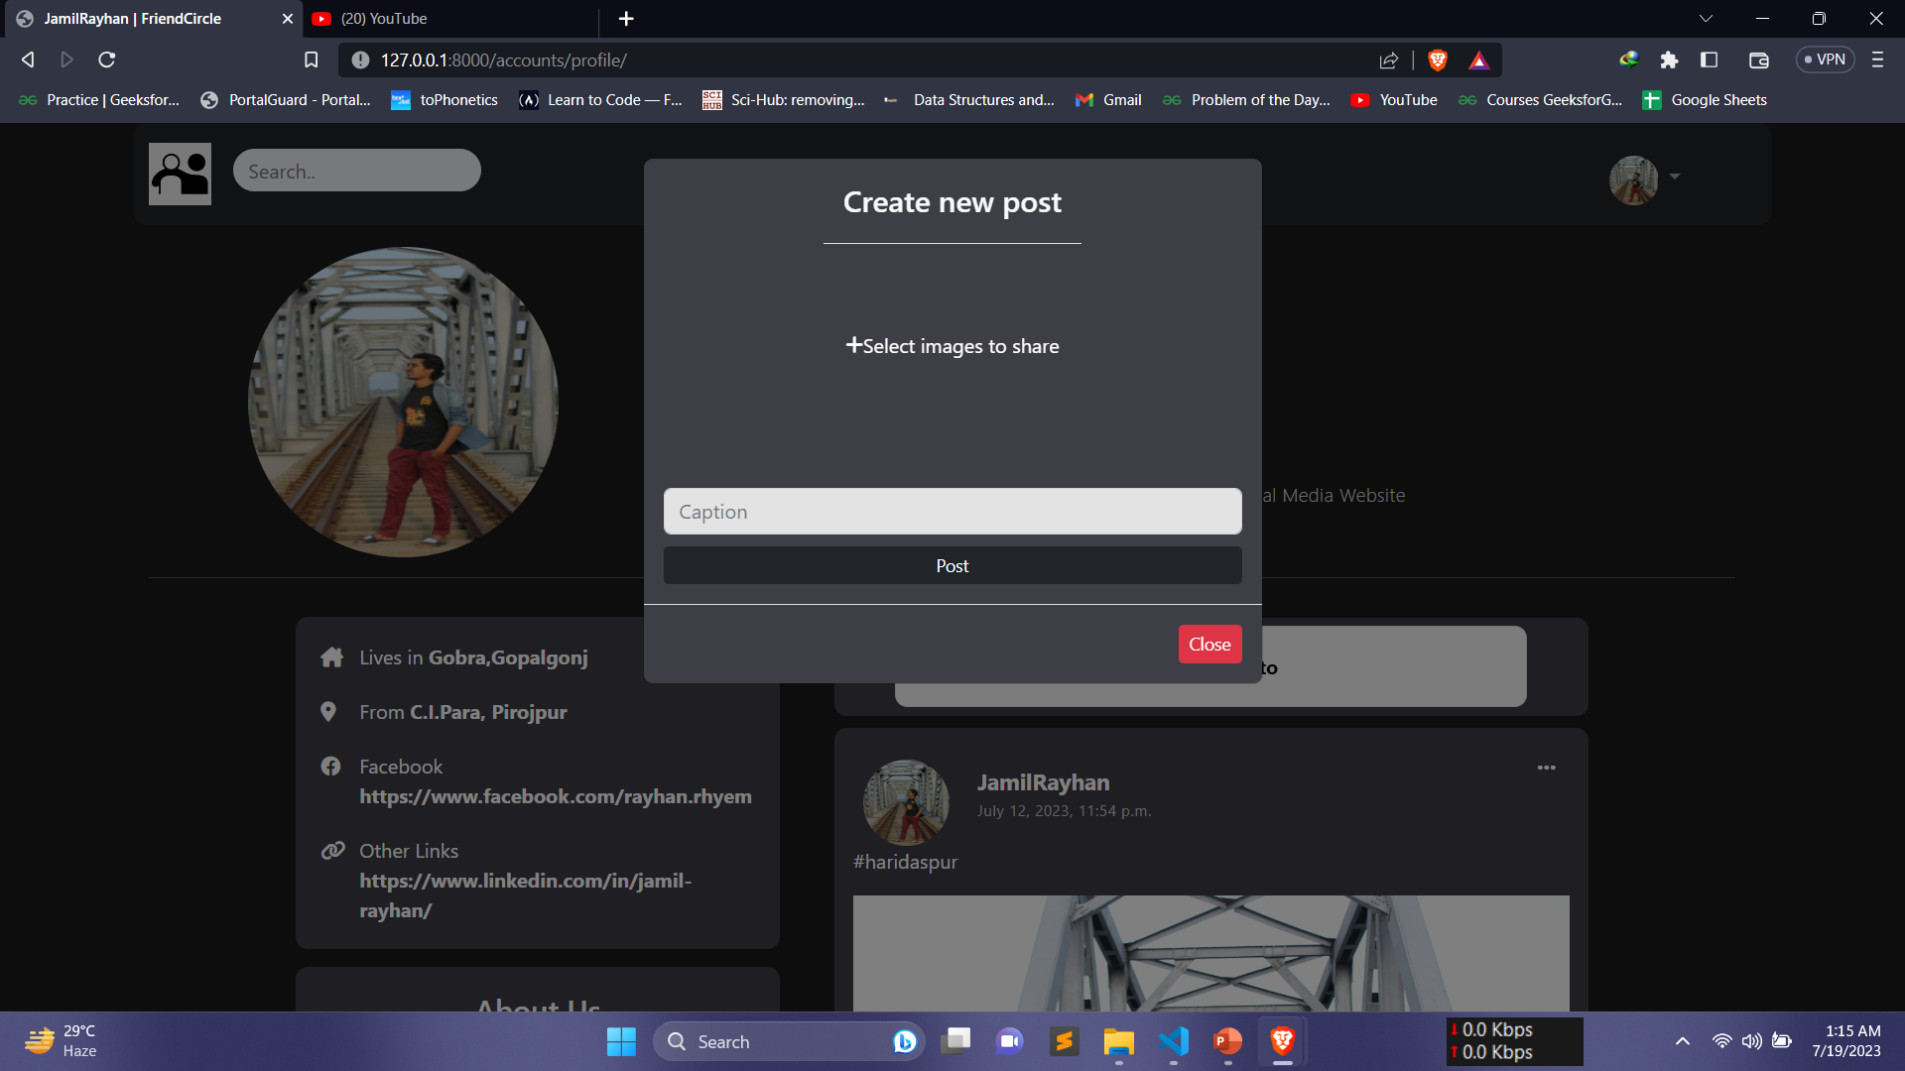
Project Visualization(cont.)

Slide 27
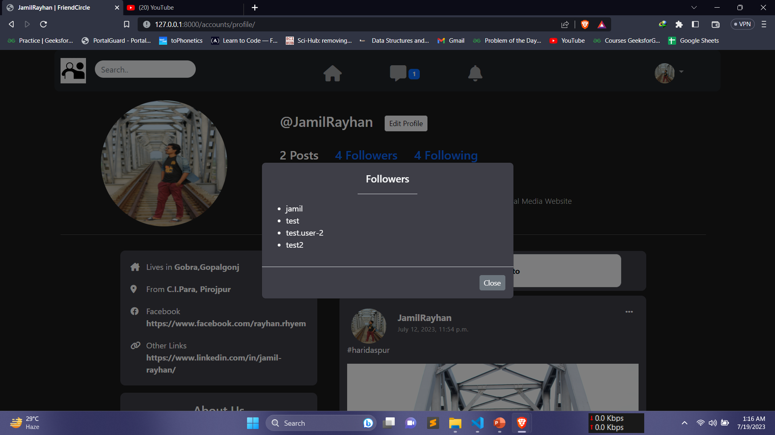
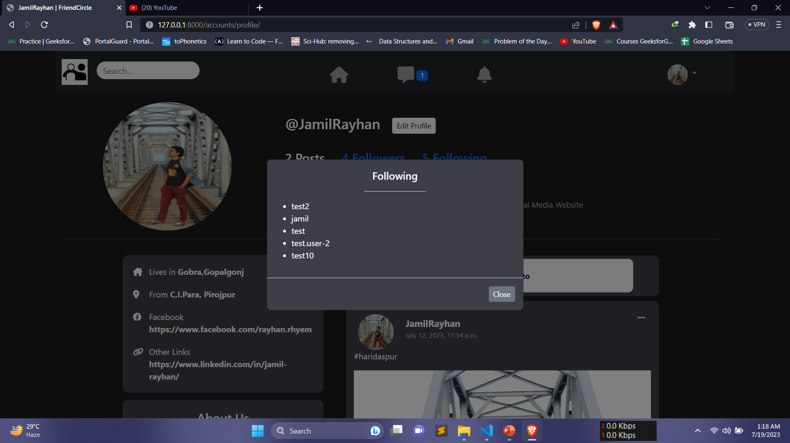
Project Visualization(cont.)

Slide 28
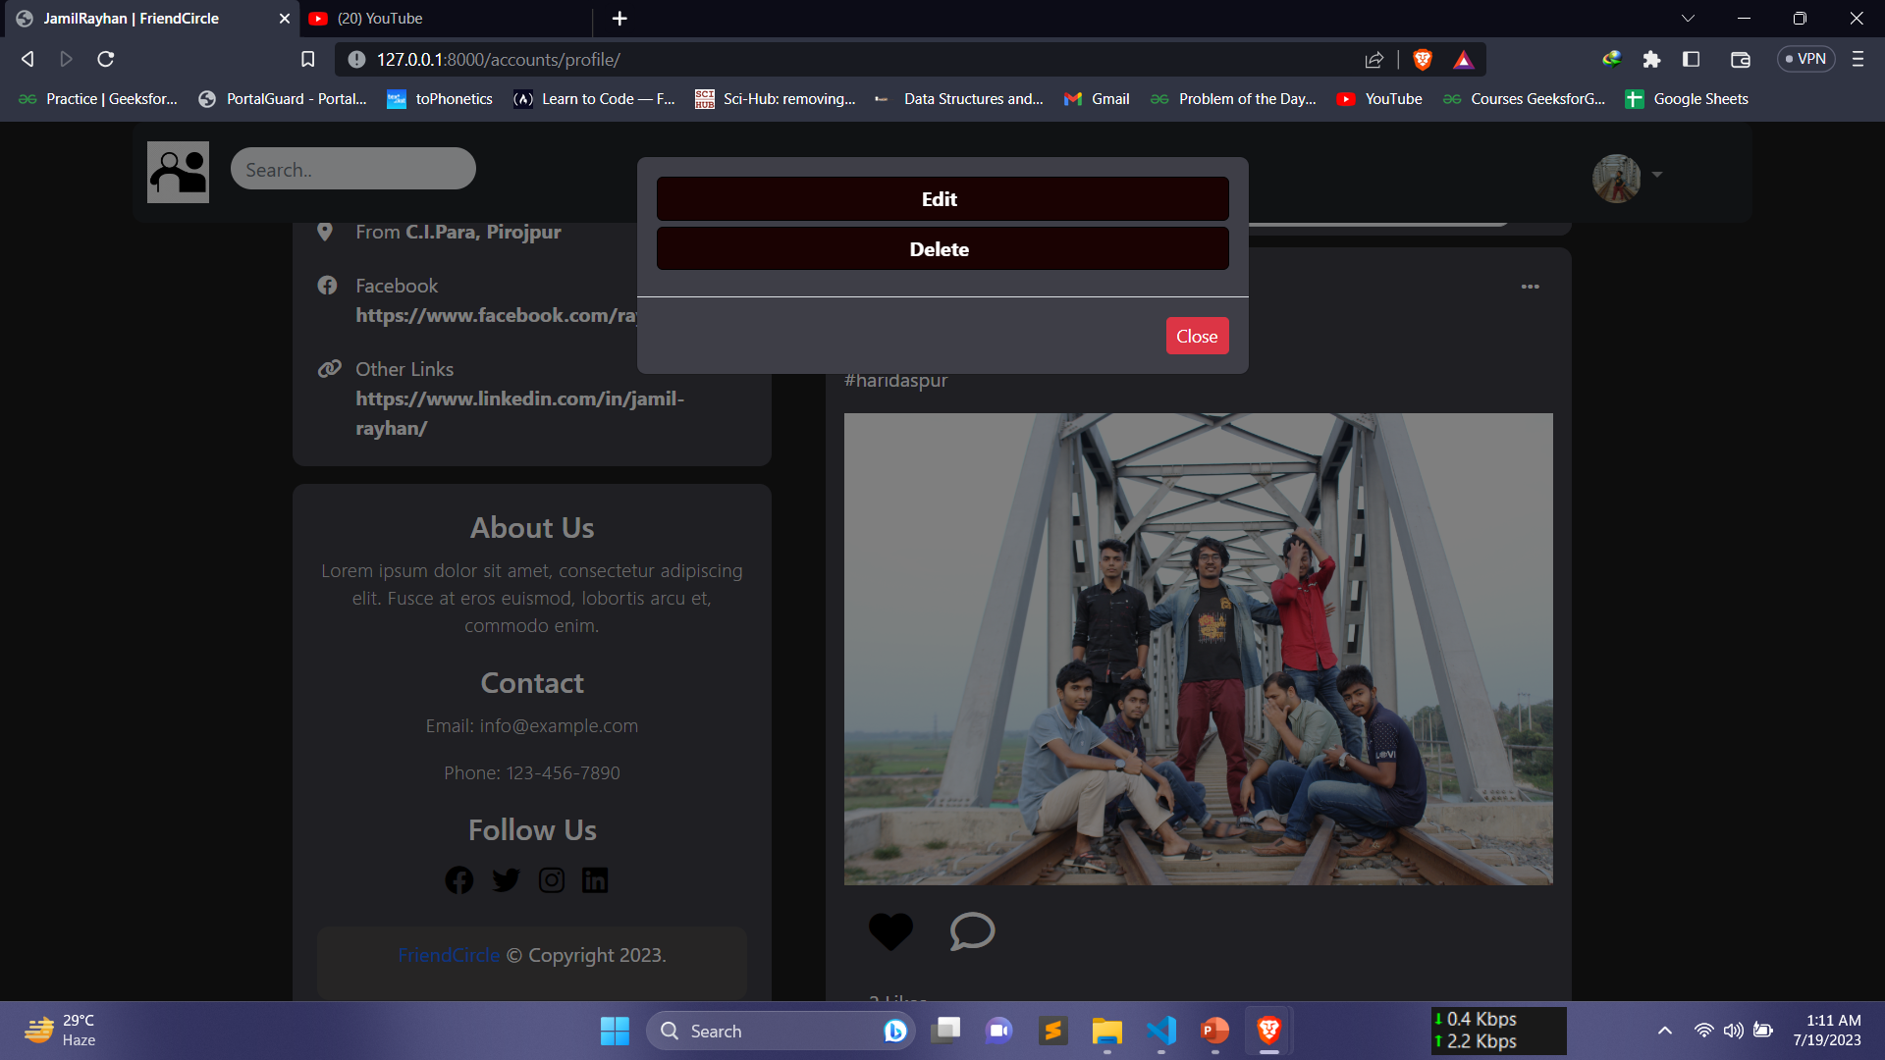
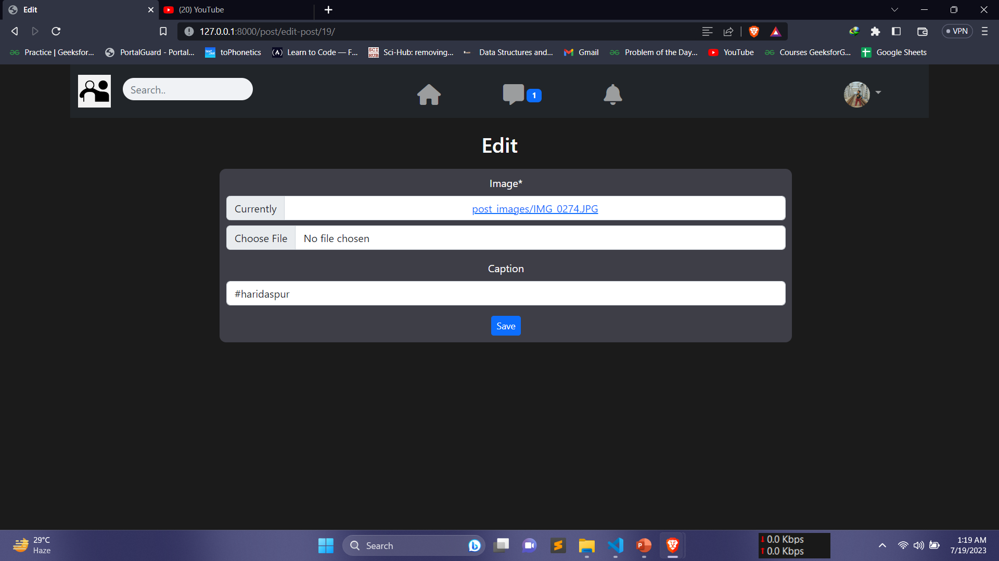
Project Visualization(cont.)

Slide 29
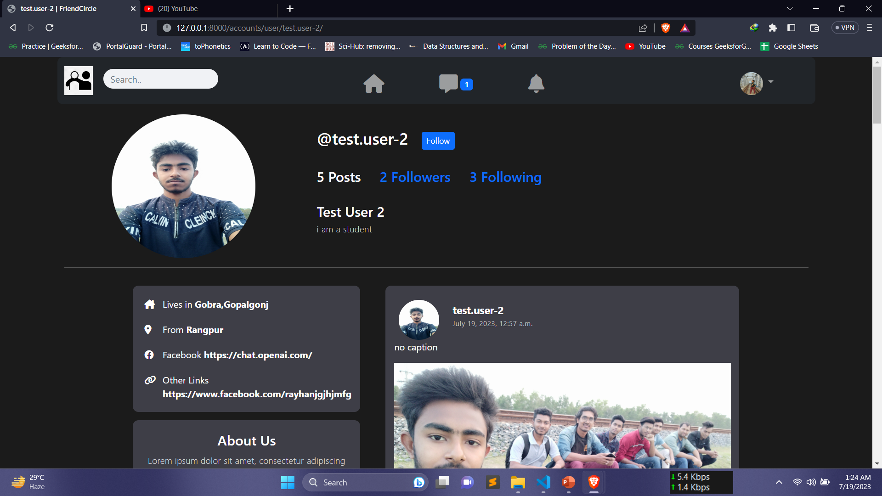

Project Visualization(cont.)

Slide 30
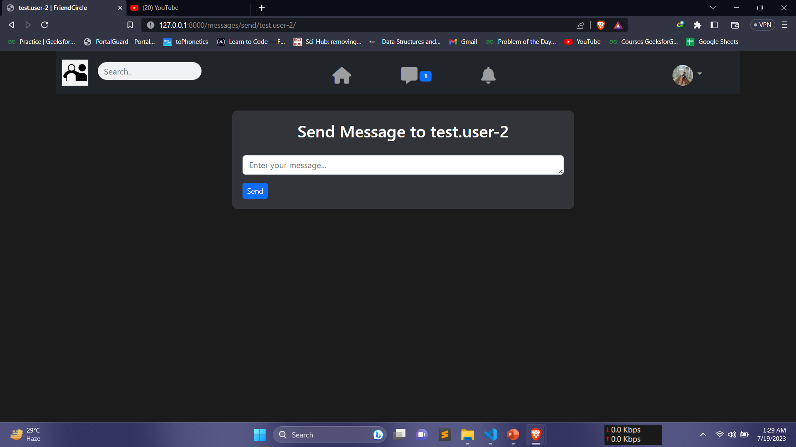
Project Visualization(cont.)

Slide 31
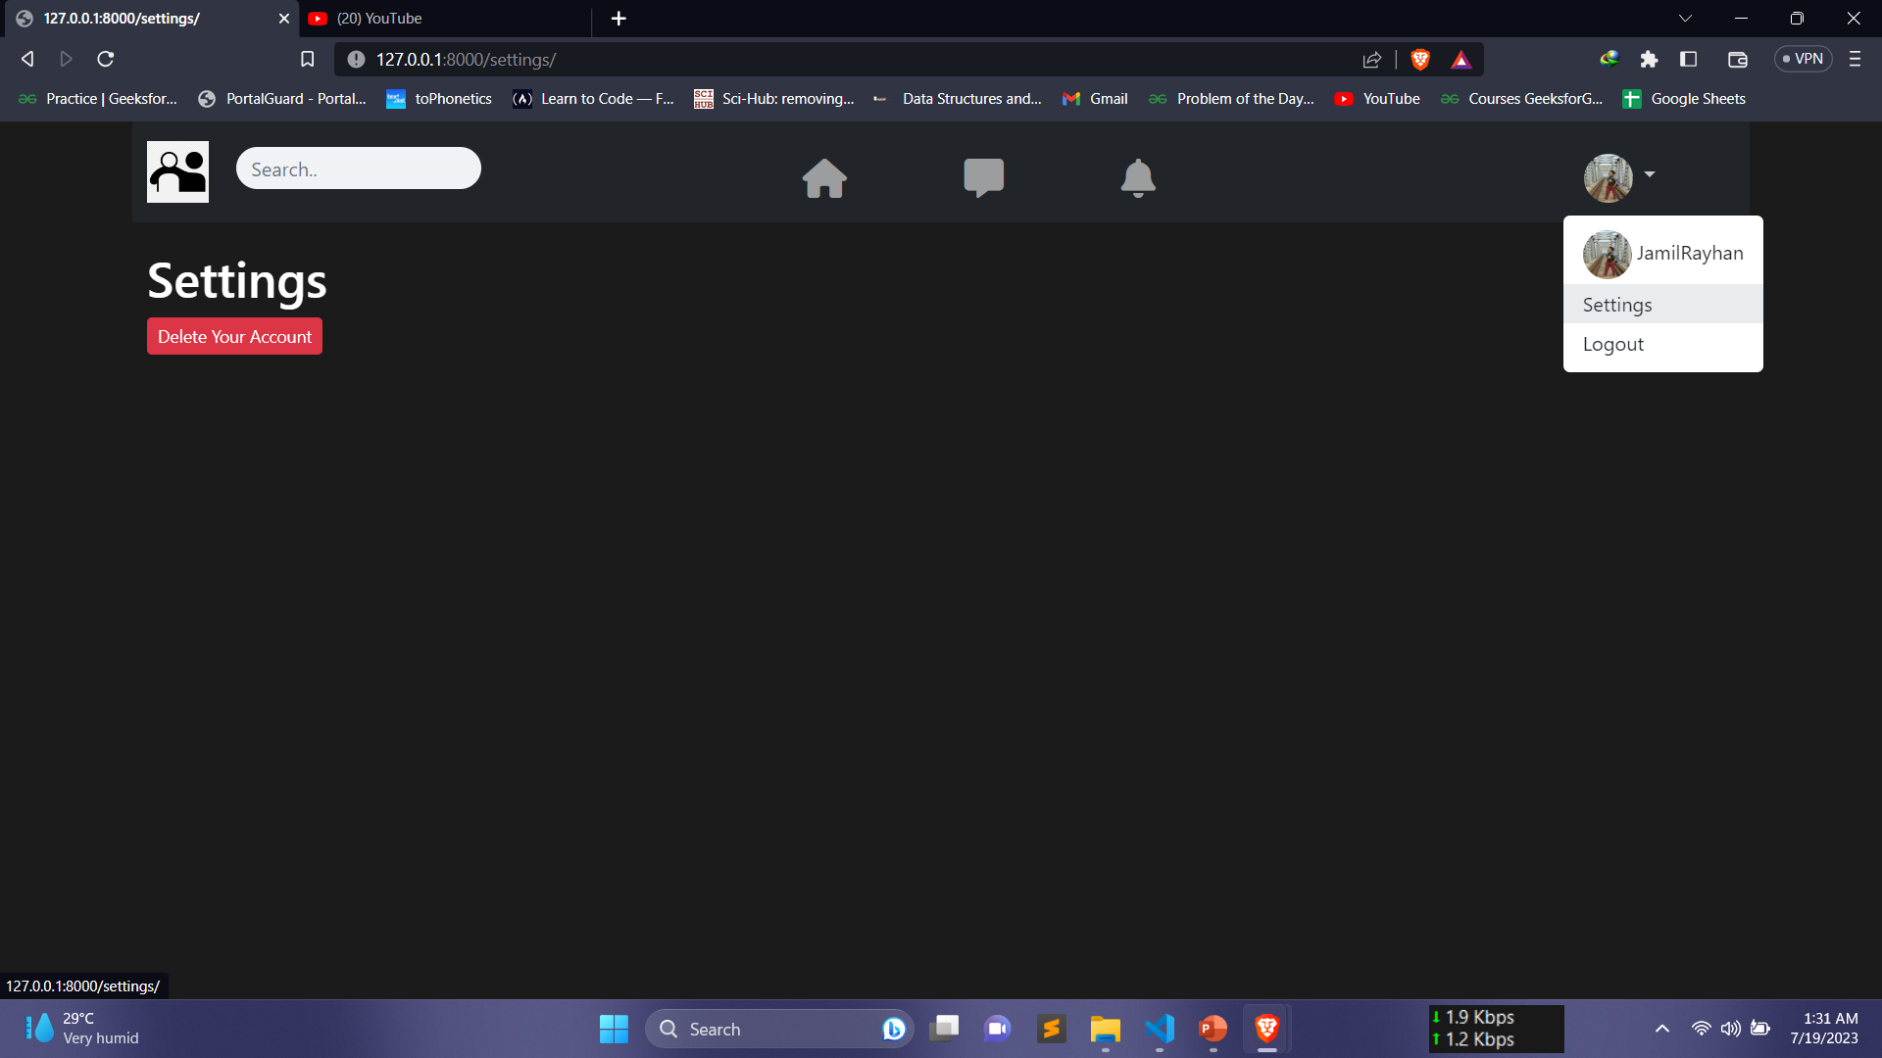
Project Visualization(cont.)

Slide 32
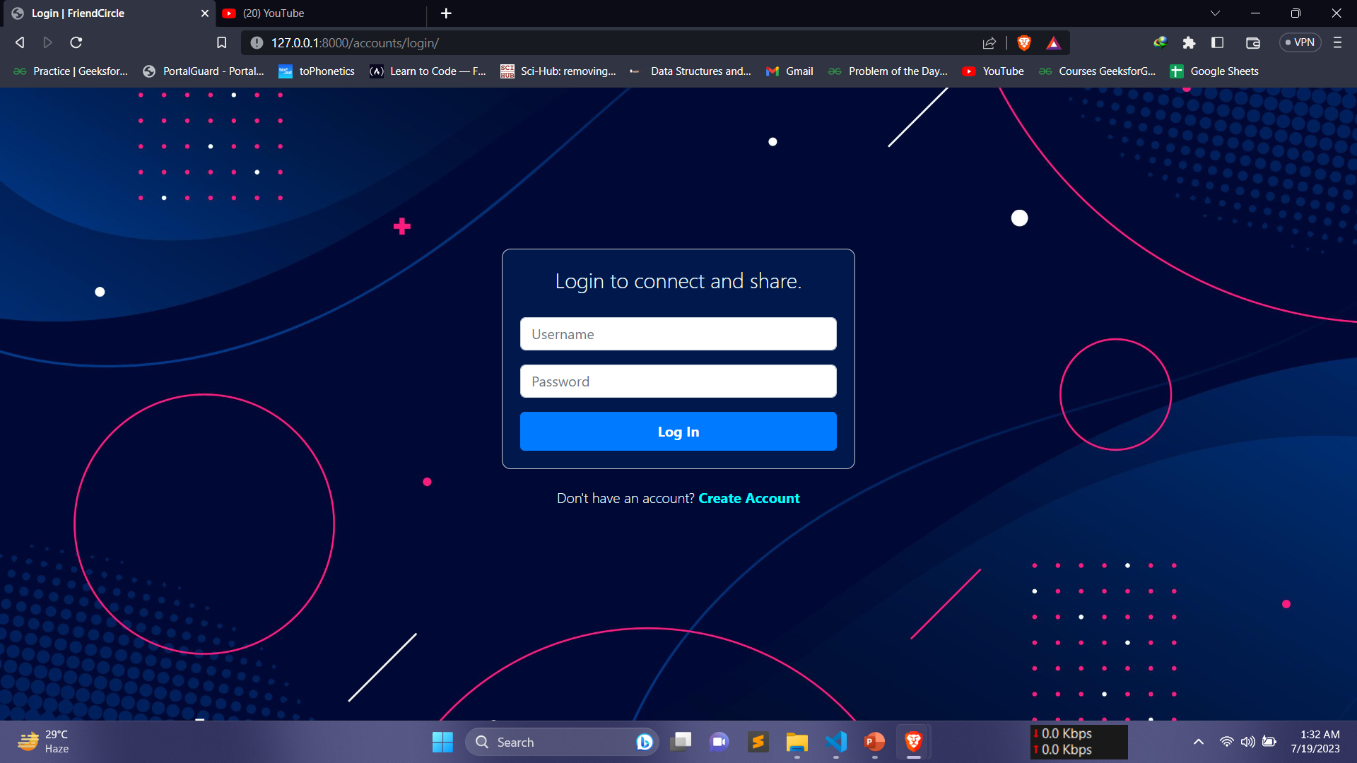
Project Visualization(cont.)

Slide 33
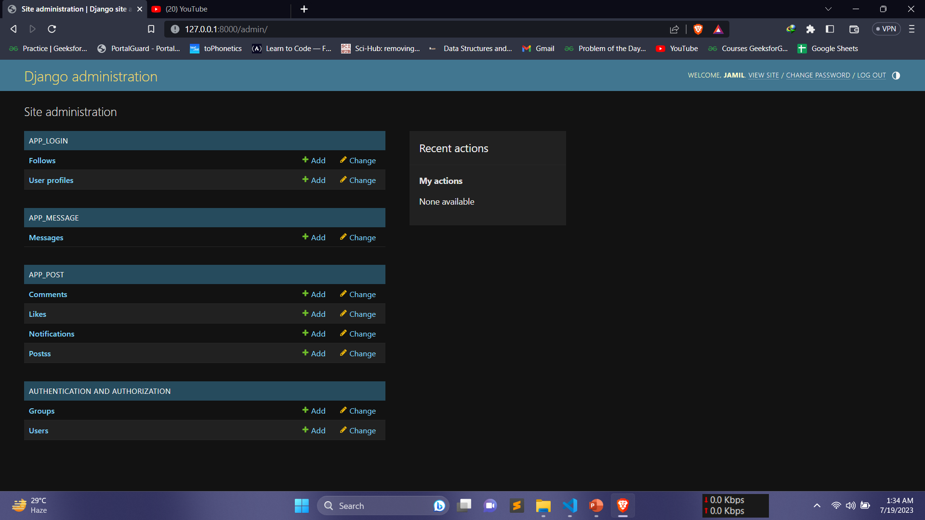
Project Visualization(cont.)

Slide 34
Outlines
Introduction
Related Works
Methodology
Visualization
Conclusion
References

Slide 35
Conclusion & Future Work
Social media is used for communication, information sharing, networking, entertainment, marketing, activism, and personal expression.
Usages of Social Media
User Friendly Interface
The project’s user friendly interface and intuitive functionality make it accessible to users of all technical expertise levels.
Future Work
Includes enhancing user experience, incorporating advanced features, expanding user base, and adapting to emerging technologies and trends.

Slide 36
Outlines
Introduction
Related Works
Methodology
Visualization
Conclusion
References

Slide 37
Reference
Boyd, D., & Ellison, N. (2007). Social network sites: Definition, history, and scholarship. Journal of Computer-Mediated Communication, 13(1), 210-230.
Kaplan, A. M., & Haenlein, M. (2010). Users of the world, unite! The challenges and opportunities of social media. Business horizons, 53(1), 59-68.
Kietzmann, J. H., Hermkens, K., McCarthy, I. P., & Silvestre, B. S. (2011). Social media? Get serious! Understanding the functional building blocks of social media. Business horizons, 54(3), 241-251.
O'Reilly, T. (2005). What is Web 2.0: Design patterns and business models for the next generation of software. Communications & strategies, 65(1), 17-37.
Rheingold, H. (2014). Net smart: How to thrive online. MIT Press.
Shirky, C. (2008). Here comes everybody: The power of organizing without organizations. Penguin.

Slide 38
Thank You

